Slide 1
Load & Stress Testing

Slide 2
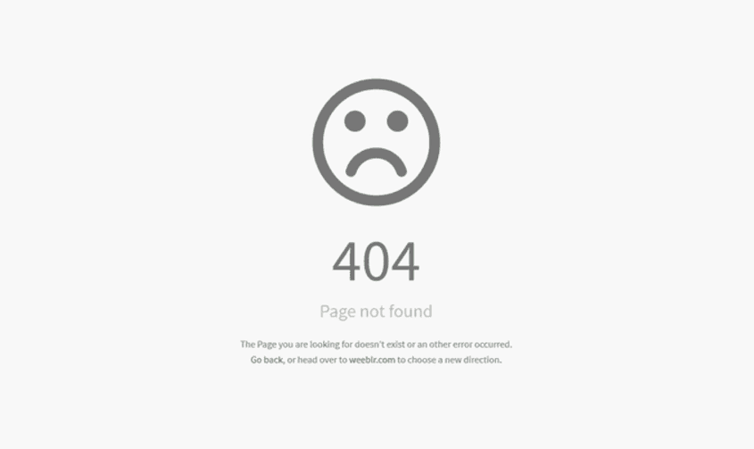
Why is it important?

Slide 3
Why Error
Too much users try to use the system.
The server can’t handle this number of users.
The system designed for 5000 users, but 10000 users tried to login.
The QA didn't perform load testing well
The QA didn't perform stress testing well

Slide 4
Load Testing
Load Testing is a type of performance testing which determines the performance of a system.
determines a system's performance under a specific expected load
It checks how the application behaves during normal and high loads.
This type of testing is applied when a development project nears to its completion.

Slide 5
Stress Testing
Stress testing is a type of software testing that verifies the stability and reliability of the system.
Stress testing is testing that checks the upper limits of your system by testing it under extreme loads.
The testing examines how the system behaves under intense loads, and how it recovers when going back to normal usage
Stress testing tries to break the system under test by overwhelming its resources.

Slide 6
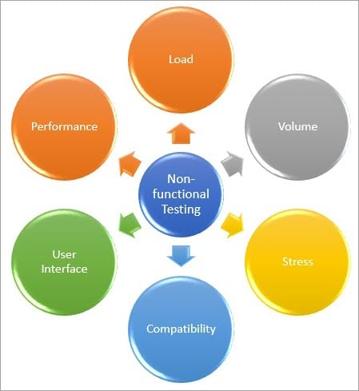
Both Are Non-Functional-Testing

Slide 7
Output of load tests
Average Response Time
The average time that it takes for a request to move from the client to the server and the response to move from the server to the client.
Peak Response Time
The longest response time that occurs within a given performance testing cycle, which represents the ‘worst case scenario’.
.
Error Rate
The percentage of errors that occur during a given performance testing cycle.
Concurrent Users
The number of users that are active at any given point in time during a performance test, which simulates real potential load situations..
Throughput
The number of kilobytes per second that’s transmitted during a performance test cycle, which illustrates the amount of data going back and forth.

Slide 8
Output of stress tests
Measuring Scalability & Performance
Pages per Second: Measures how many pages have been requested / Second
Throughput: Basic Metric – Response data size/Second
Rounds: Number of times test scenarios have been planned Versus Number of times a client has executed
Application Response
Hit time: Average time to retrieve an image or a page
Time to the first byte: Time is taken to return the first byte of data or information
Page Time: Time is taken to retrieve all the information in a page
Failures
Failed Connections: Number of failed connections refused by the client (Weak Signal)
Failed Rounds: Number of rounds it gets failed
Failed Hits: Number of failed attempts done by the system (Broken links or unseen images)

Slide 9
How is it beneficial to our program?
STRENGTHS
Throughput
Response time
Speed
Stability
Resource usage
Recovery
WEAKNESSES
Page load issues
System lag
Additional issues arising when multiple users accessing the system
S
W
OPPORTUNITIES
provides stakeholders
with crucial information about their application that affect their product.
THREATS
Memory leaks
Race conditions
Synchronization issues
O
T

Slide 10
Why not acceptance & unit testing?
Testing purpose - Functional tests are testing the accuracy of the software with definite inputs against expected output while the performance tests verify the behavior of the system at various load conditions.
Uses of Load & Stress testing (which are not covered by functionality testing) -
Verify the numbers of concurrent users which an application can support, and scalability to allow more users to access it.
Check out that current infrastructure is sufficient to run the application or not.
Assure that application able to achieve the performance point recognized during performance testing.
Determine the operating capacity of an application
Discovering new bugs (hardware) - which are not possible with the other testing methods. Such as memory management memory leaks, bugs, buffer overflows, etc
Discovering new failures and vulnerabilities:
Make sure that the system has saved the data before crashing or not.
Check whether any unexpected failures do not harm the system security

Slide 11
So what is the solution?

Slide 12
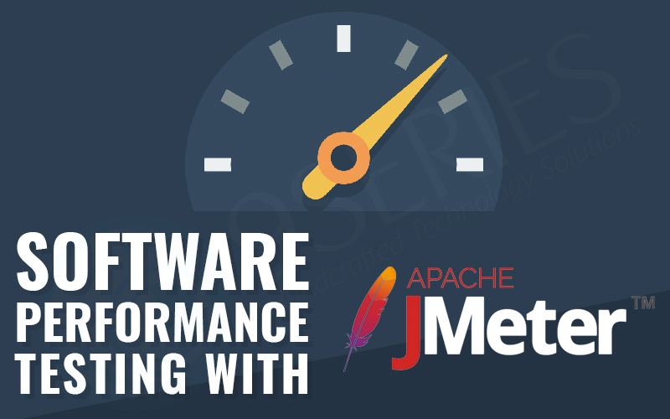
Apache JMeter™
The application is open-source software, a 100% pure Java application designed to load test functional behavior and measure performance.
It can be used to simulate a heavy load on a server, group of servers, network or object to test its strength or to analyze overall performance under different load types.

Slide 13
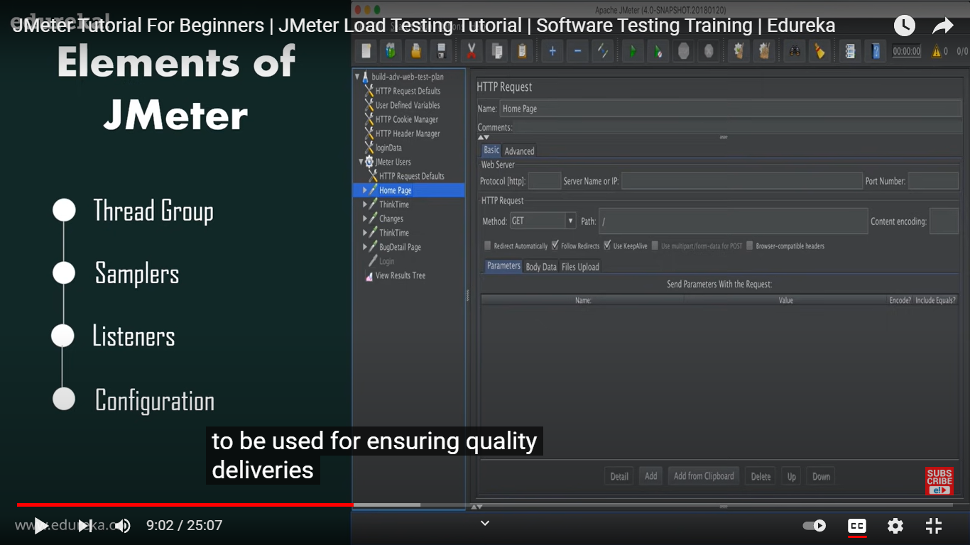
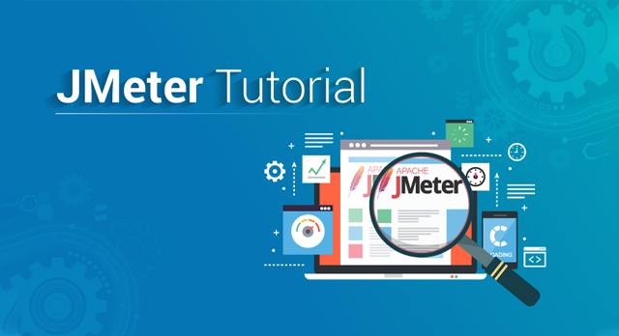
JMeter Elements

Slide 14
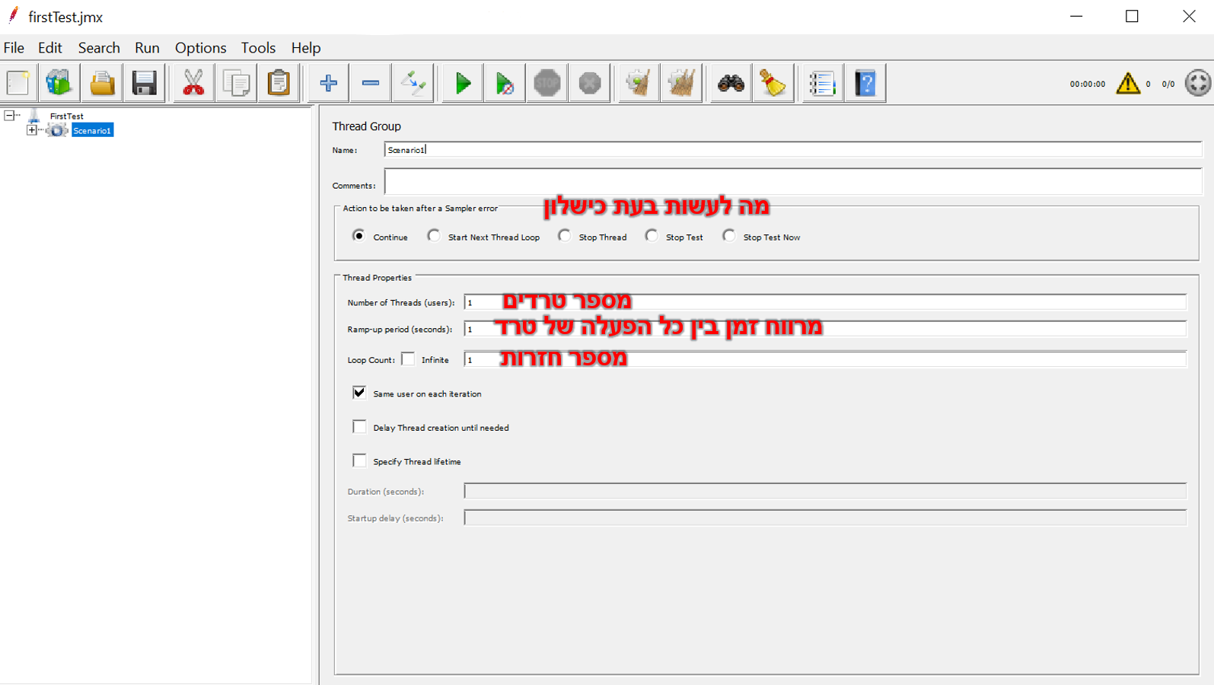
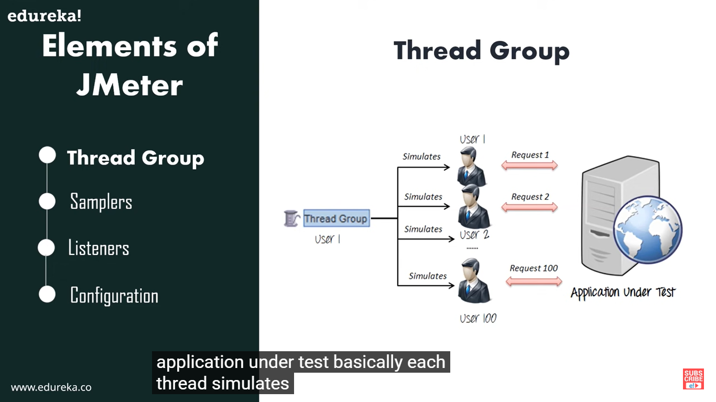
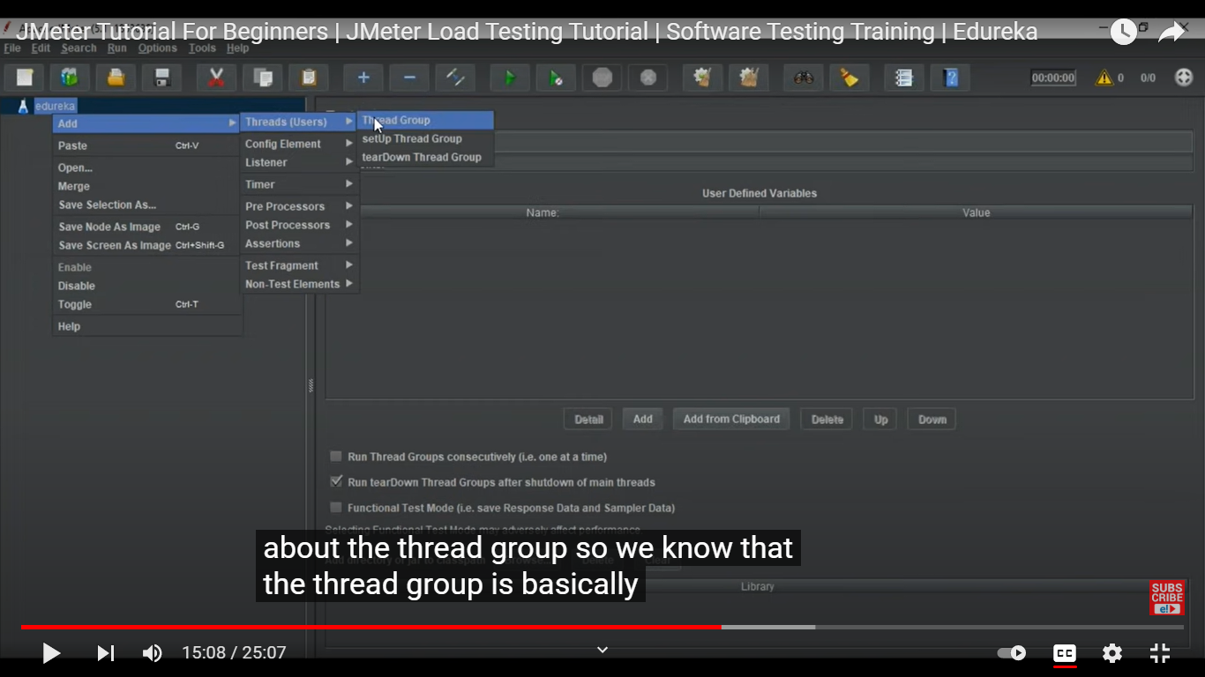
Thread group
Access through:
מה לעשות בעת כישלון
מספר טרדים
מרווח זמן בין כל הפעלה של טרד
מספר חזרות

Slide 15
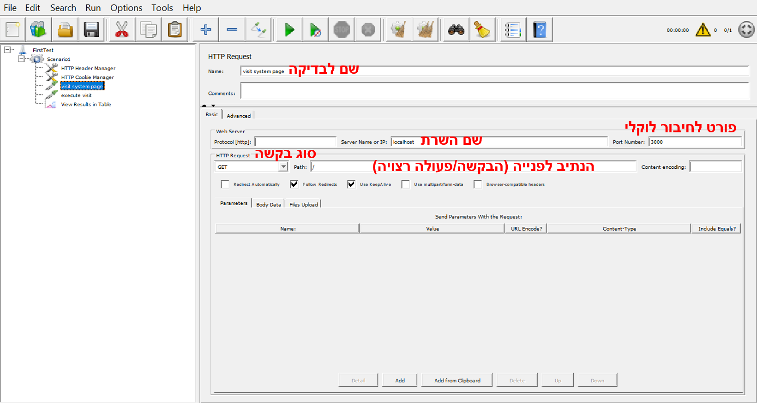
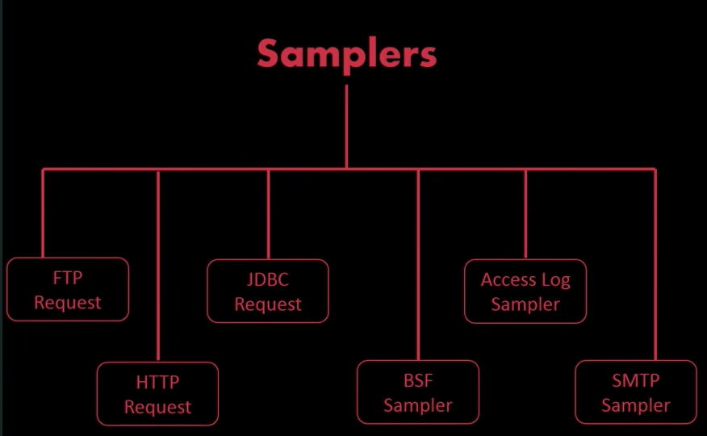
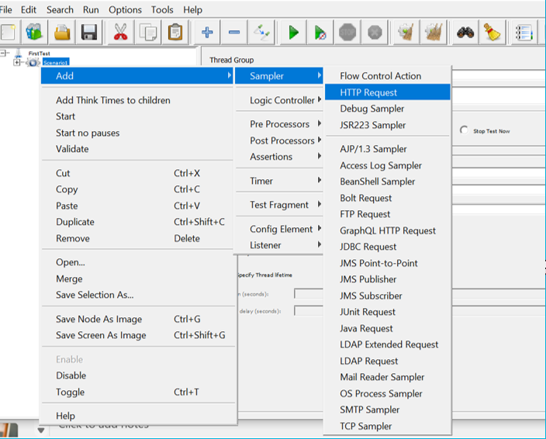
Samplers
Access through:

Slide 16
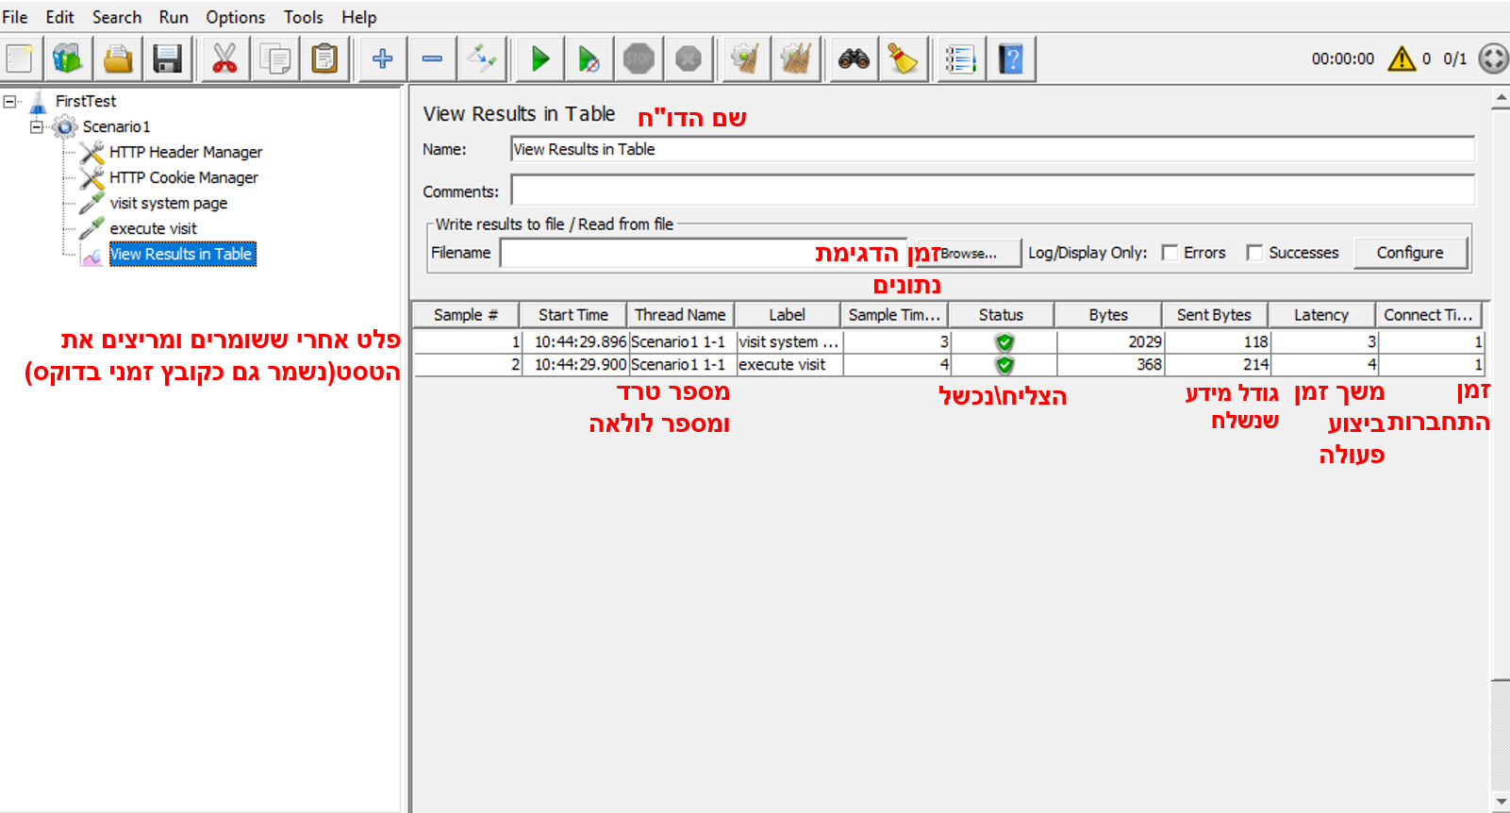
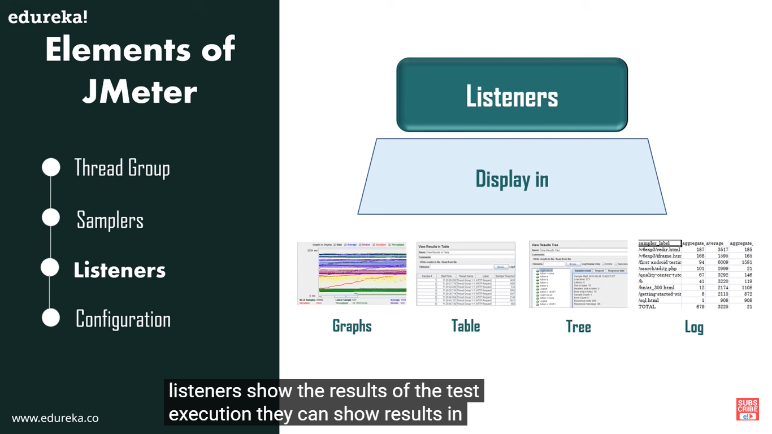
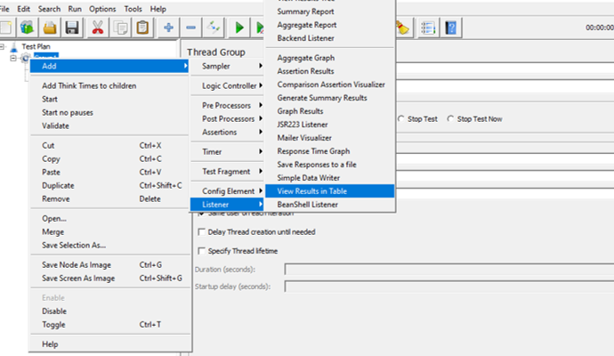
Listeners
Access through:

Slide 17
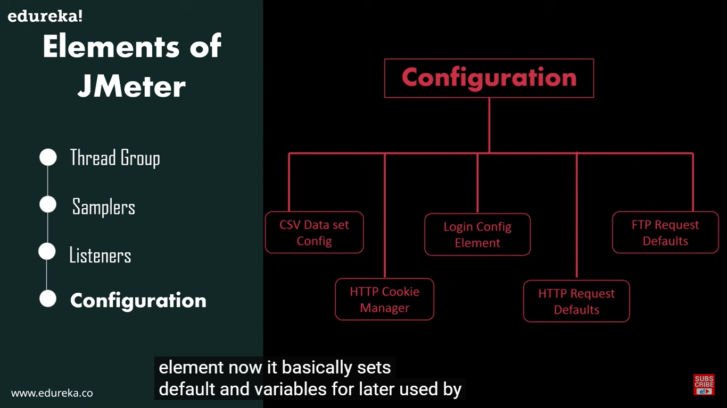
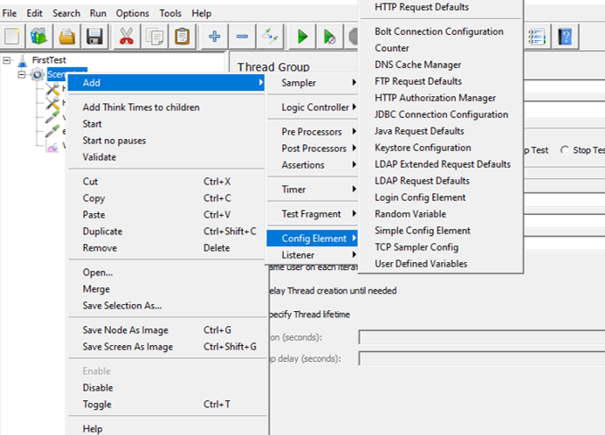
Configuration
Access through:

Slide 18
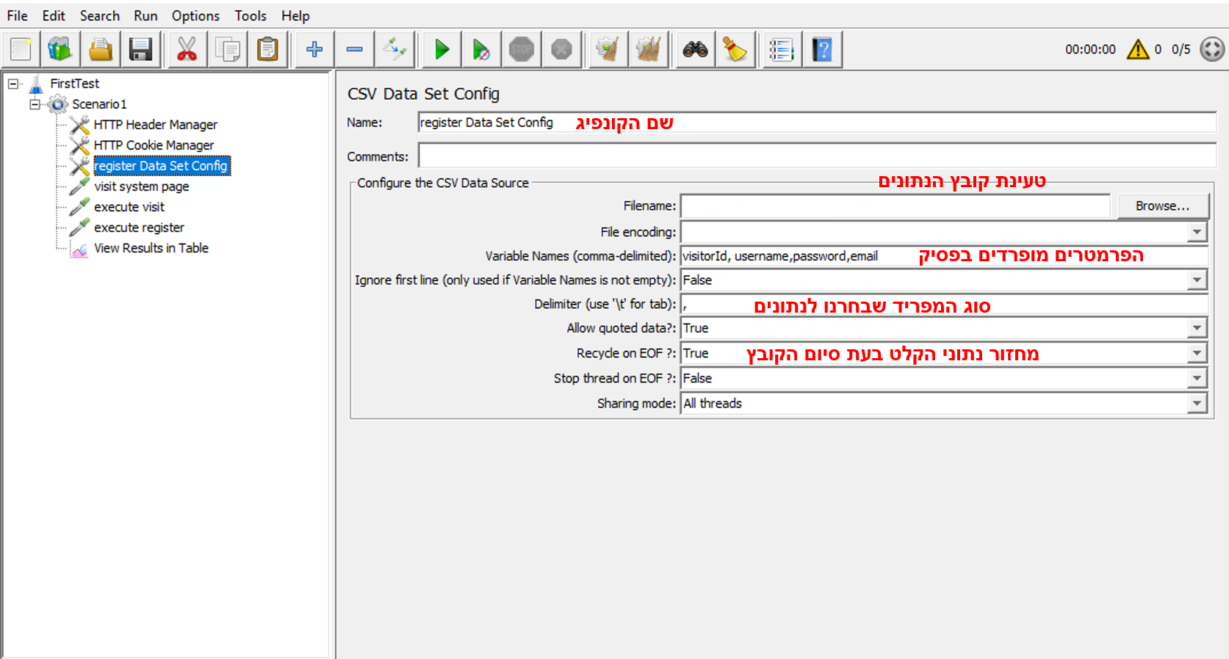
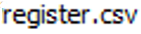
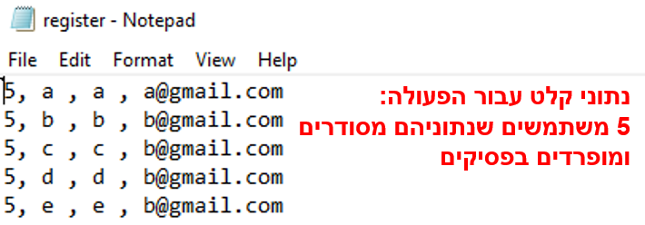

Slide 19
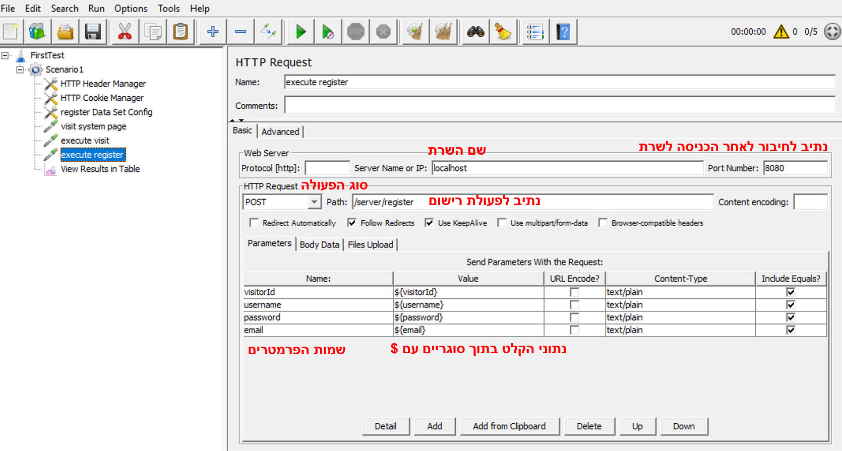

Slide 20
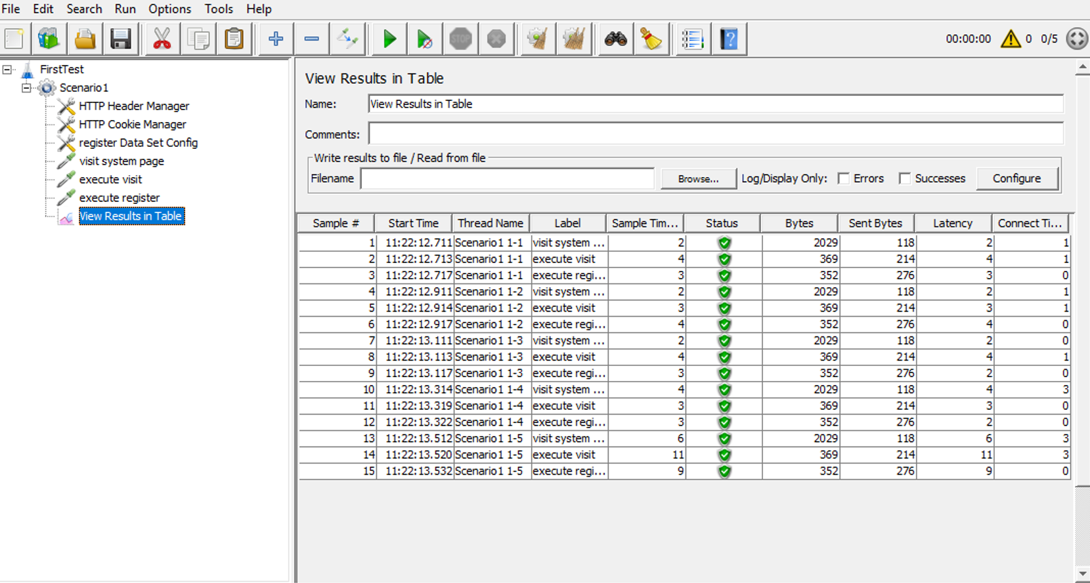

Slide 21

How do we use it?

Slide 22
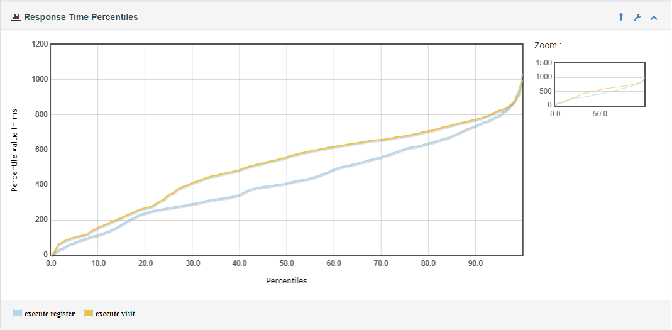
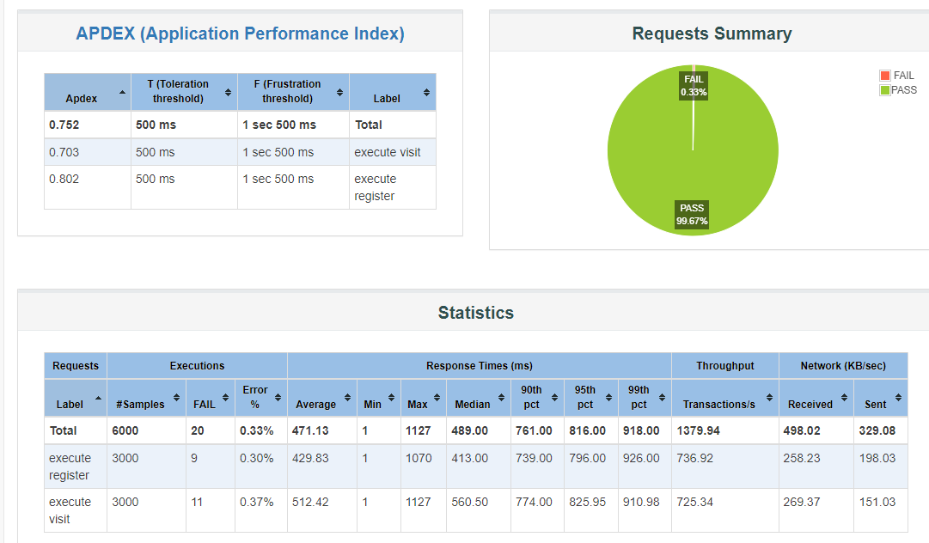
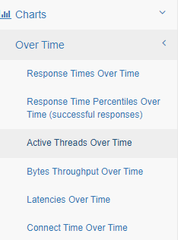
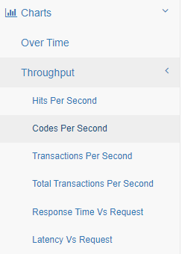
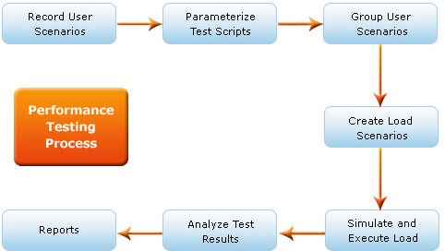
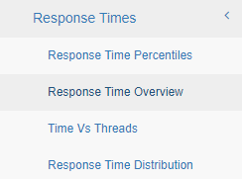
Identify the performance bottlenecks
Analyze client-side report to find bad behavior:
High response time
High latency
Low throughput
Errors
increasing Bytes downloaded for every request
Analyze server-side report
CPU, Memory, Disk I/O, Network I/O, and JMX.
Eliminate outer resources such as DB for pure code evaluation.
Compare between the reports to identify suspicious components
Find the bottlenecks using pattern matching and fix the issues.
Bottlenecking — This occurs when data flow is interrupted or halted because there is not enough capacity to handle the workload.
Notes:
observed very high disk write response times, often in excess of second. This is represents really poor performance!
A logical bottleneck on the database server, due to an inefficient stored procedure
An I/O bottleneck on the database server
When we looked at queue lengths on the disk, our diagnosis of a disk bottleneck were confirmed. Here we see average queue lengths of over 9,000 requests!!
he Application Server was a configured with 2 hyper-threads. So this was the 100% of one logical processor was the maximum CPU that could be consumed by this process.
This indicated that the application server was CPU bound.
A CPU bottleneck on the application server

Slide 23
Examples for testing scenarios
Scenario 1
Do variuos actions on the system
Increase the amoust of user commiting visit system
Search for bottleneck at the user entry point to the system
Scenario 2
Add some of the same products to various users carts
purchase these products stimultansly from thee users
Search for purchase bottlenecks and synchronization issues
Scenario 3
Register few members to the system
Login to the same members from many visitors stimultansly
Search for login bottlenecks and synchronization issues

Slide 24
THANKS!
Any questions?

